Slide 1
Community Detection Between AED Locations and Population Density in Zürich
Mattias Dürrmeier, Christian Galley, and Olivia Lecomte
Notes:
ALT: AED Location Optimisation / Recommendation in Zürich

Slide 2
Concept
Sudden Cardiac Arrest (SCA) is one of the leading causes of death with only a 6% survival rate
CPR and the use of an Automated External Defibrillator (AED) significantly improves survival rate when started within 4-5 minutes post-onset
Less than 25% of SCA patients receive CPR from a bystander
Less than 4% benefit from the use of an AED by a bystander
Retrieval of an AED is typically allocated 2 minutes
There are no laws in Switzerland that require businesses and public places to have an accessible AED
Notes:
Olivia

Slide 3
Goal
Perform community detection on AEDs and population density in Zürich with the goal of optimising device locations
Notes:
Olivia

Slide 4
Goal
Find the shortest path between a randomly initialised point and an AED
Assess whether this return journey can be completed within 2 minutes
Notes:
Olivia

Slide 5
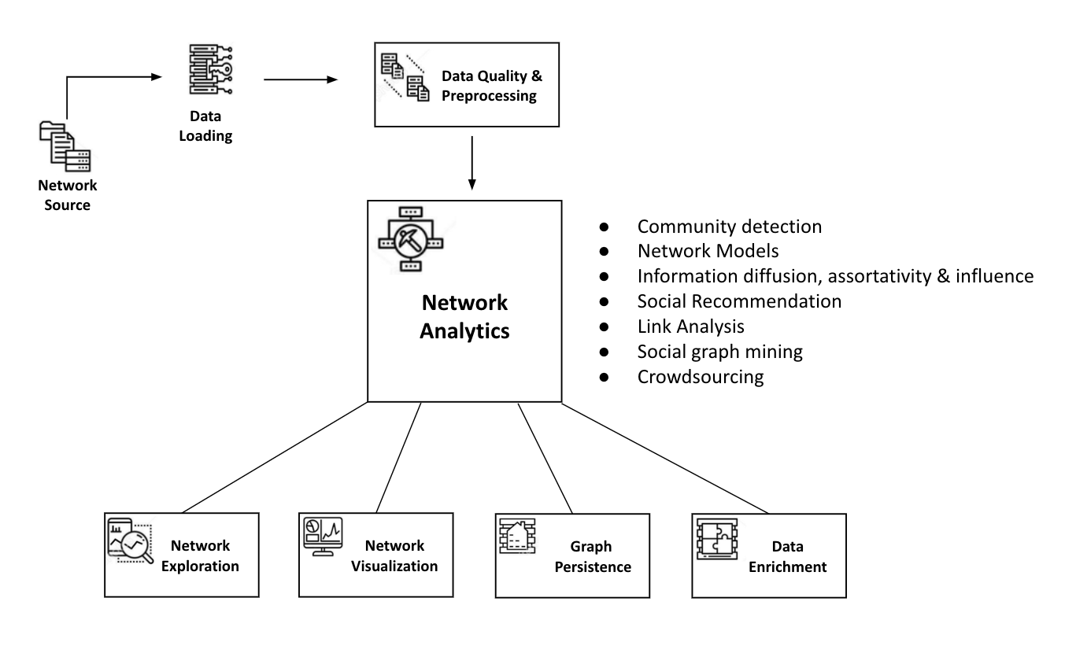
Network Source
OpenStreetMap Data
District of Zürich
2 different queries:
Dataset 1: AED
Dataset 2: Geospatial data
Humanitarian Data Exchange
Population density
Cardiac Arrest Data
SWISSRECA - TBD
Notes:
Mattias

Slide 6
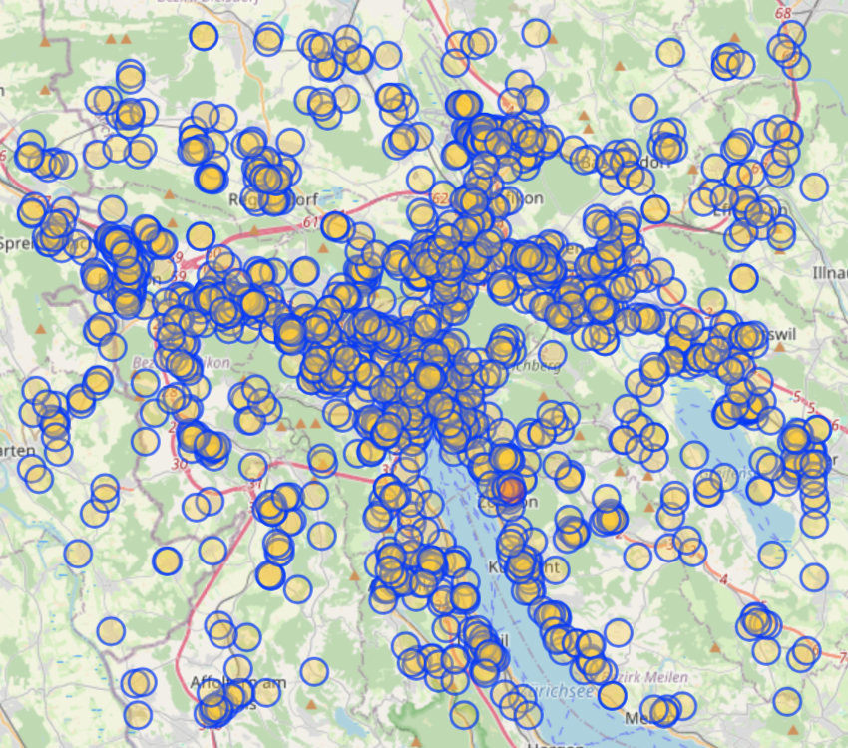
Dataset 1: AED Location
#nodes = 1’565
Metadata: coordinates, ID, address, amenity (e.g., ‘pharmacy’), business name, business hours, etc.
Notes:
Mattias
Check query for hosp and pharma
Possible loc for an aed: unis, gov buildings, restaurants, bars and clubs – thru amenities

Slide 7
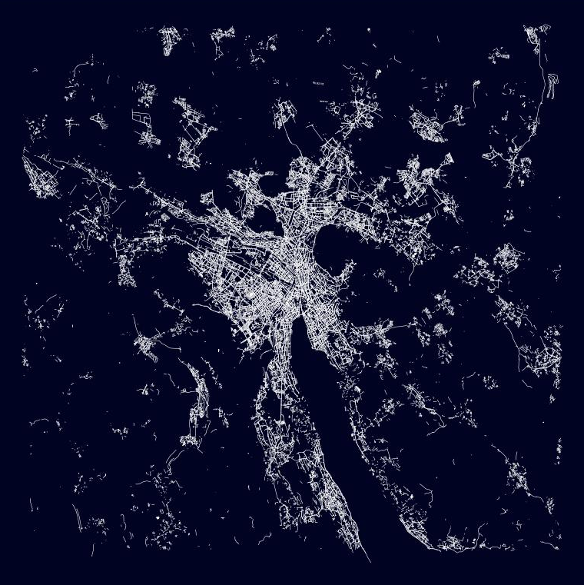
Dataset 2: Geospatial Data
#edges = 56’466
Intersections between roads
pedestrian pathways
Undirected
Weighted, based on distance (km)
Notes:
Mattias
Geopandas and compare with swiss topo

Slide 8
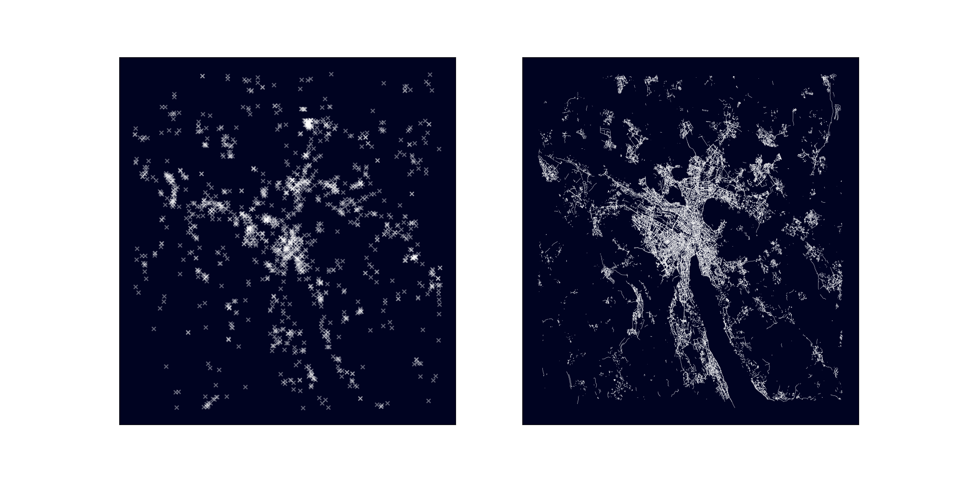
Datasets Side-by-Side
Notes:
Mattias
Features?
Could we label medical buildings as sep to public places like businesses?

Slide 9
Data Loading
GeoPandas for transformation
H3 (hexagonal hierarchical geospatial indexing system)
NetworkX for graphing

Slide 10
Data Quality & Preprocessing
Creation of 2 graphs:
AED locations
Nodes = AED
Edges = distance
Weights = ?
Population density map
Cleaning data of unnecessary information
TBD

Slide 11
Network Analysis
Community detection of Population Density and AED
Louvain
Leiden
Surprise
Walktrap
Use information to recommend optimal AED locations

Slide 12
Network Exploration and Visualisation
Community detection analytics
Runtime
Optimisation
Accuracy?
Visualisation with Python or other tools
Gephi?
Notes:
Scalability to CH
Runtime, acc, optimisation

Slide 13
Graph Persistence and Data Enrichment
Graph Persistence:
Neo4j or other
Data Enrichment:
Use of various data sources for the creation of graphs
Possibility to include time series
Scalability to Switzerland

Slide 14
Analytics
Graph Traversal
Goal: initialise a random point (the patient) and calculate the shortest distance to an AED and back along pedestrian pathways
Algorithms: Greedy Search, A, and A*
Node Prediction/Recommendation
Goal: determine the most strategic placements for x number of new AED devices
Q: What type of analysis is this?
Notes:
Mattias
Recommendations are more interesting.
Could we still run the graph traversal to make sure that the recommendations are significantly better? How many would we need to add in order to make it accessible? Is it mainly in the suburbs?
QUESTION? Which of the network analytics does the node prediction fall under? Network modelling?

Slide 15
Hypothesis and Test
Hypothesis: not enough AEDs to successfully help patients within the critical time frame
Method:
Weighted graph (weights represent distance in km)
One-Sample T-test:
Randomly initialise 200+ points on the geospatial dataset
Calculate the time to walk to and from an AED at an average walking speed of 5 km/hr
Time = speed/distance
Compare to critical value of 2 minutes
Notes:
Olivia

Slide 16
Thank you! Any questions?
Notes:
QUESTIONS:
1. How does the work have to be divided? By section of the pipeline or just equally? Do we keep a log?
Don’t forget about the pipeline.
Scalability to CH
Runtime and acc
Does implement mean we have to code it ourselves and then the rest we can use from packages?
Final remarks
Network analysis needs to be the central element – decide on that by checking syllabus
Implement and compare algorithms – given in course or other
Report about comparison of algs – runtime, optimisation, acc, anything else
Make the project centralised
Add numbers to the slides and a title ;)
Classification per intersection

